Slide 1

Classification of Document Embedded Images
Manish Kumar - B17CS032
Mayank Maheshwari - B17CS034
Guide :-
Dr. Gaurav Harit,
Department of Computer Science and Engineering
Indian Institute of Technology, Jodhpur

Slide 2
Motivation

Slide 3
Problem
Images embedded in Documents carry vital information for Content Extraction. Thus before Interpreting them we need a Classifier that can recognize the potential variability of Embedded Images

Slide 4
SOLUTION
A Deep Neural Network based classifier with RESNET50 as its feature extractor and a Fully connected classifying unit with layers of dropout regularizer, appended at its end.

Slide 5
Applications :-
(Correspond To real world problems )
Provide a way to handle the Extraction of information from any type of Document with more accuracy.
Classifying Images helps us to Extract information from those image

Slide 6
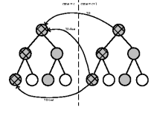
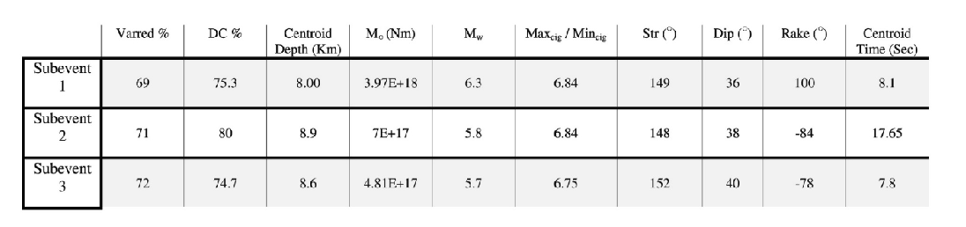
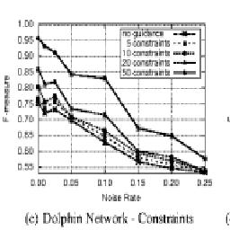
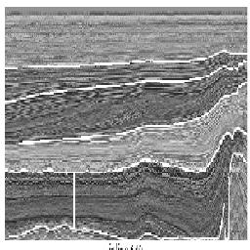
Dataset :-
320 PDF
892 Images
4 Classes
- 393 Plot images
- 274 Table images
- 117 Graphs
- 108 Diagrams

Slide 7
Network Architecture :-
Input Image
Converted to Gray Scale Image
Convert Image into its Matrix form
Normalizing the Data Matrix
Pre-processing of Data
Output
Update Weights
Fully
Connected layers
RESNET50
(feature extractor)
Classification Model

Slide 8
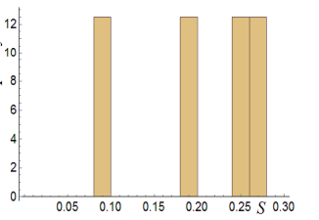
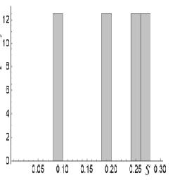
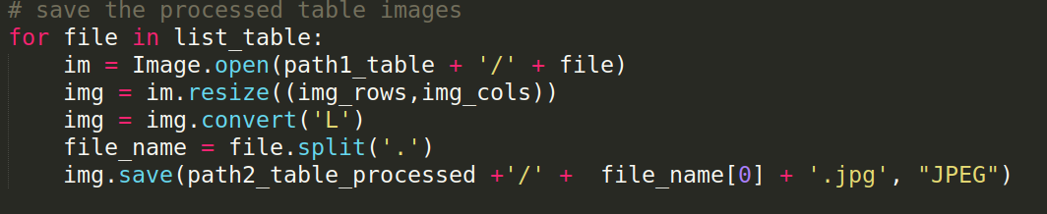
Converting To Gray Scale Images :-
Input
Output
Code Snippet

Slide 9
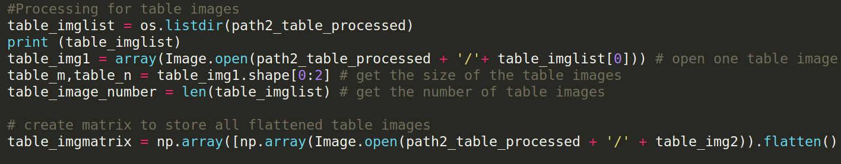
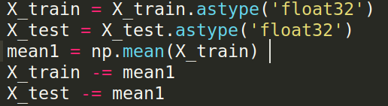
Converting and Normalizing the Data :-

Slide 10
Why ResNet ?

Slide 11
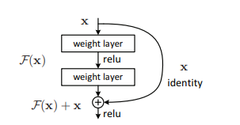
Deep Residual Learning for Image Recognition
(Kaiming He, Xiangyu Zhang, Shaoqing Ren, Jian Sun)
Winner of 1st place on the ILSVRC 2015
Solves the problem of training deep Neural Networks by providing SKIP connections
Skip Connection

Slide 12
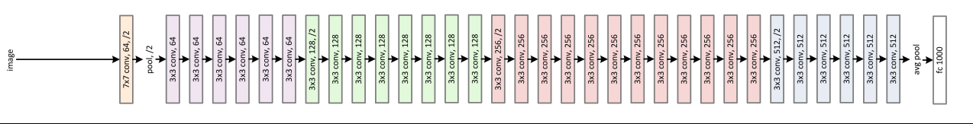
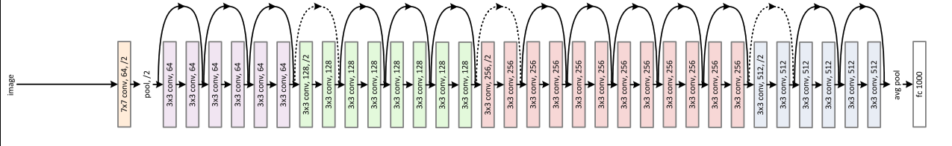
ResNet Structure :-
Simple Neural Network
ResNet Network

Slide 13
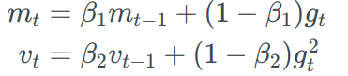
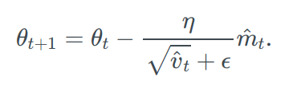
Optimizer Used :-
Adam: A Method for Stochastic Optimization
(Diederik P. Kingma, Jimmy Lei Ba)
Adaptive Moment Estimation (Adam) is optimizing algorithm
In addition to storing an exponentially decaying average of past squared gradients(vt). It also stores average of exponentially decaying past gradients(mt).

Slide 14
What we have done?

Slide 15
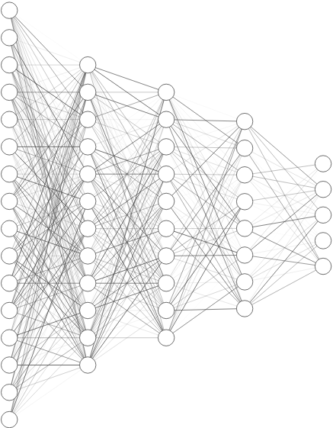
Architecture -
X1
X2
.
.
.
.
.
.
.
.
.
.
.
.
.
.
ResNet
Input
Output
Feature Vector
Fully Connected Classifier

Slide 16
Dependance on various Hyper Parameters

Slide 17
Hyper Parameters
A quantity which helps us to finalizes the value of various parameters ( such as weights and bias ) in our final model are known as Hyper-Parameters.
For example:
Learning Rate ( Alpha )
Number of iterations ( Epochs )
Number of Hidden layers ( L)
Batch Size

Slide 18
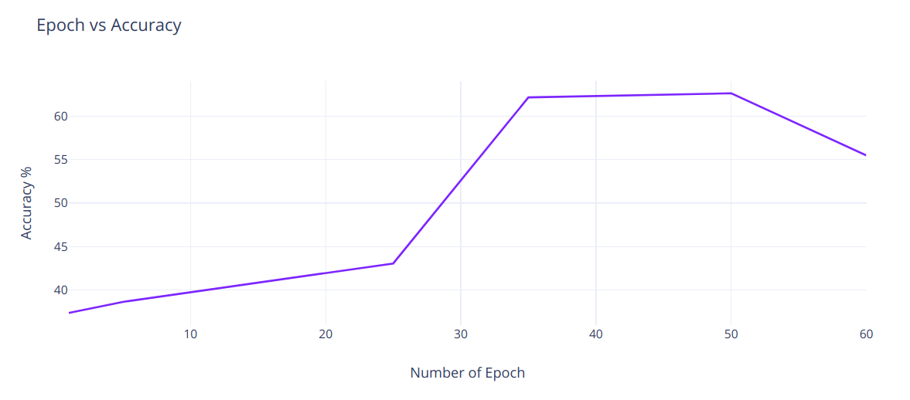
Dependance on Epochs
Number of Epochs | Accuracy
1 | 37.34%
5 | 38.61%
25 | 43.04%
35 | 62.19%
50 | 62.66%
60 | 55.5%
All other hyperparameters are constant :
Learning Rate - 0.001, Hidden layers = 5, Batch Size = 32

Slide 19
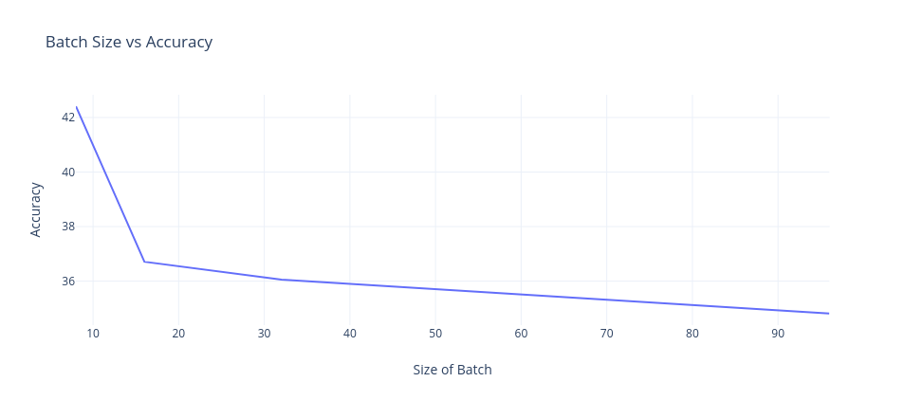
Dependance on Batch Size
Batch Size | Accuracy
8 | 42.41%
16 | 36.71%
32 | 36.08%
64 | 35.44%
128 | 34.81%
All other hyperparameters are constant :
Learning Rate - 0.001, Hidden layers = 5, Epoch = 5

Slide 20
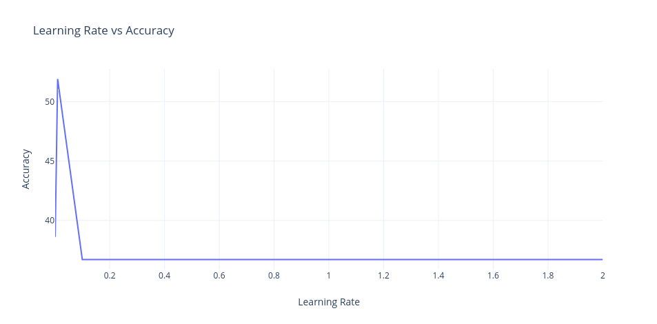
Dependance on Learning Rate
Learning Rate | Accuracy
.001 | 38.61%
.01 | 51.90%
.1 | 36.71%
1 | 36.71%
2 | 36.71%
All other hyperparameters are constant :
Epoch - 5, Hidden layers = 5, Batch Size = 32

Slide 21
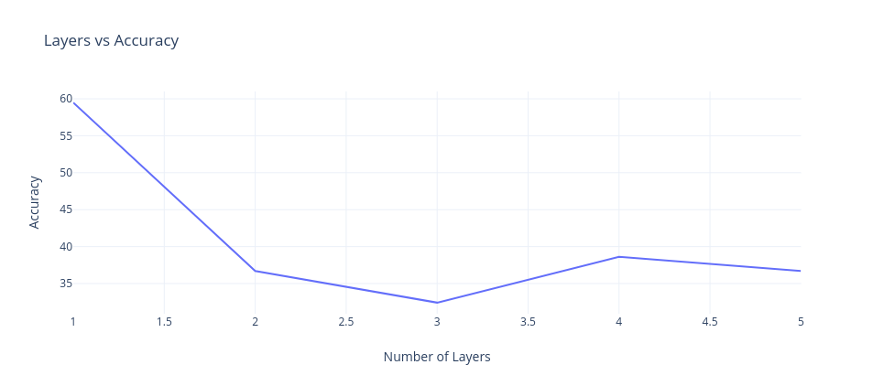
Dependance on Number of Layers
Number of Layers | Accuracy
5 | 36.71%
4 | 38.61%
3 | 32.42%
2 | 36.71%
1 | 59.49%
All other hyperparameters are constant :
Epoch - 5, Learning Rate = 0.01, Batch Size = 8 *layers are of classifier network

Slide 22
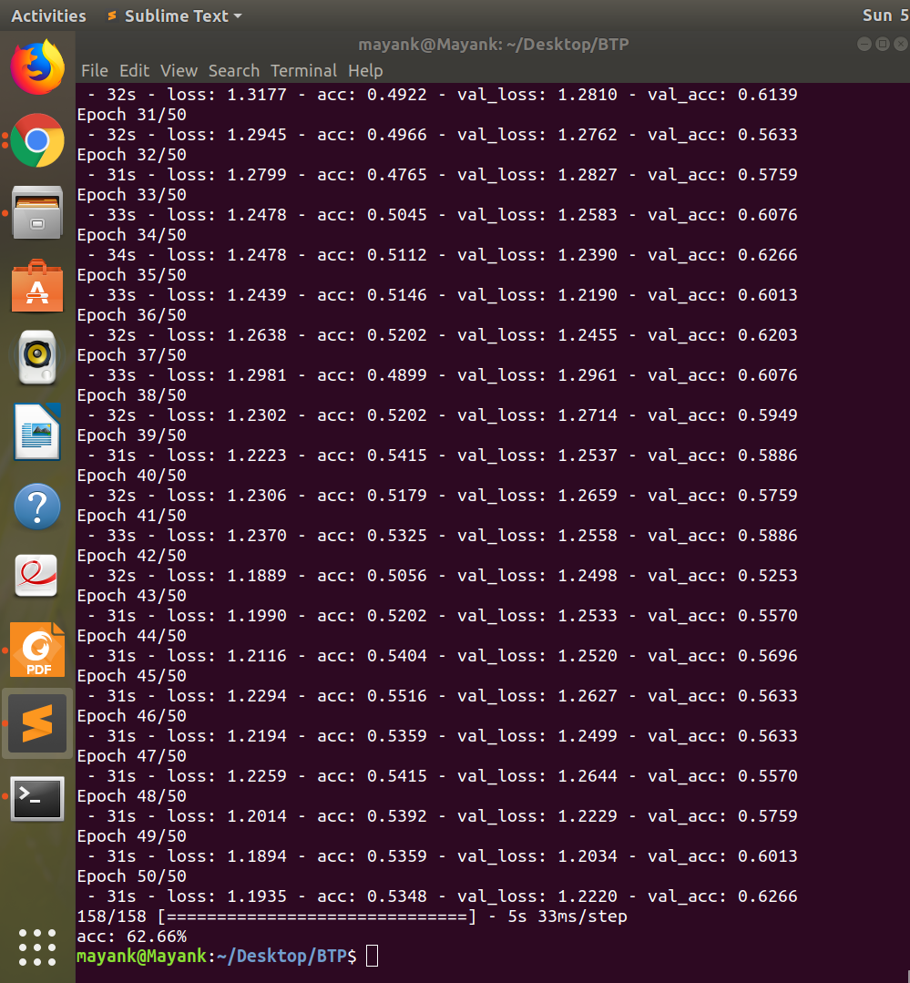
Results
Accuracy:
Testing- 62.66%
Training- 53.48%
Hyperparameters:
Epochs = 50
Learning rate = 0.01
Batch Size = 8
Number of Layers = 5

Slide 23
Individual Results :-
Accuracy :
For only Plots :~ 69% ( 68.95% )
For only Tables :~ 87% ( 86.86% )
For only Graphs :~ 46% ( 46.15% )
For only Diagrams :~ 42% ( 42.32%)

Slide 24
Future Work
After classifying the image, we can now work on other models which helps us to understand the extracted data using image captions and other information.
More data can be collected so that we can add more classifying classes to our model and make it robust.

Slide 25
References :
Diederik P. Kingma: “Adam: A Method for Stochastic Optimization”, 2014; [http://arxiv.org/abs/1412.6980 arXiv:1412.6980].
Kaiming He, Xiangyu Zhang, Shaoqing Ren: “Deep Residual Learning for Image Recognition”, 2015; [http://arxiv.org/abs/1512.03385 arXiv:1512.03385].
Viana, Matheus & Nguyen, Quoc-Bao & Smith, John & Gabrani, Maria. (2018). Multimodal Classification of Document Embedded Images: 12th IAPR International Workshop, GREC 2017, Kyoto, Japan, November 9-10, 2017, Revised Selected Papers. 10.1007/978-3-030-02284-6_4.

Slide 26
Thank you

